Slide 1
UI Design

Slide 2
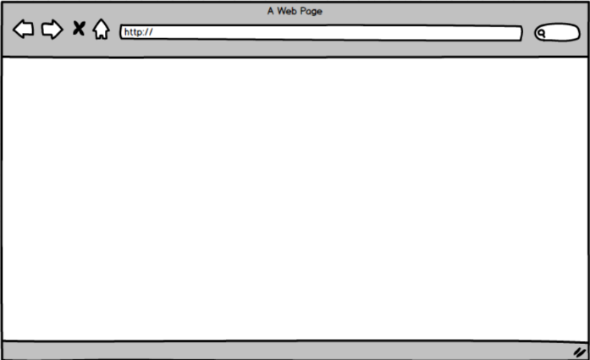
Main page
Login
Sign Up
Stress
Biological Age

Slide 3
Login
Login
Sign Up
ID
Stress
Biological Age
PW
Login

Slide 4
Sign up
Login
Sign Up
Sign up
Rainbow System에 개인정보 제공에 동의 하시겠습니까?
Stress
Biological Age
No
Yes

Slide 5

Update
SDK 님
개인정보 설정
Information Update
수동
Period

Slide 6
Stress
SDK 님
Stress
History
2nd Analysis
GSR
EEG
Pulse
GSR
EEG
Pulse
Stress
34.5
Biological Age

Slide 7
Stress History
SDK 님
Stress
Weekly
Monthly
Yearly
History
2nd Analysis
GSR
EEG
Pulse
Biological Age

Slide 8
Stress 2nd Analysis
SDK 님
Stress
Weekly
Monthly
Yearly
History
2nd Analysis
GSR
EEG
Pulse
Biological Age

Slide 9
Biological Age
SDK 님
Stress
Biological Age
BMI
Weight
Blood Pressure
History
2nd Analysis
BMI
Weight
Blood Pressure
Stress
34.5

Slide 10
Biological Age History
SDK 님
Stress
Weekly
Monthly
Yearly
Biological Age
History
2nd Analysis
BMI
Weight
Blood Pressure

Slide 11
Biological Age 2nd Analysis
SDK 님
Stress
Weekly
Monthly
Yearly
Biological Age
History
2nd Analysis
BMI
Weight
Blood Pressure

